Slide 1
Members in Transition Committee
The Role of Oil and Gas in the Next 100 Years.
March 3, 2017

Slide 2
Outline
A lookback – At the last 100 years
The art of forecasting.
What will be the role of oil and gas in the next 25 years?
Conclusions

Slide 3

The Last 100 Years
Geologists Ralph Arnold, left, and H R Johnson, in field outfits, near McKittrick. Arnold carries a camera, binoculars, and a field bag for rock samples. Johnson adds a canteen.
So,
if we asked someone in 1917 what the industry would be like in 2017, what would they have said?
Source: “Spudding In”, Bill Rintoul, 1976

Slide 4
The First Well Log
1927 Henri-Georges Doll joins the company, initially part-time Doll and his team record the first electrical resistivity well log in Pechelbronn, France A new term was coined to describe the results of this multi-depth survey: it was called an electrical resistivity well log.
1929 Subsurface surveying is carried out in Argentina, Ecuador, India, Japan, the Soviet Union, Venezuela and the USA . The USA’s first ever well log is performed in Kern County, California
1931 This was followed by another breakthrough, with the introduction of the Spontaneous Potential (SP) log.
Source: http://www.slb.com/about/history/1920s.aspx
Notes:
It took until 1920 for Conrad Schlumberger to publish the results of the experimental surface resistivity measurements he had carried out since 1911.
In the same year, Conrad and Marcel opened their first office at 30 rue Fabert in Paris.
Conrad’s focus on making geophysical measurements became all-consuming now, prompting him to resign his professorship at École de Mines, Paris in 1923.
Conrad and Marcel spent the next three years conducting geophysical surveys in Serbia, Canada, South Africa, Congo and the USA, as well as Romania, where they made the first mapping of an oil-productive salt dome using electrical prospecting.
In 1926, they created the Société de Prospection Électrique, or “Pros” as it was nicknamed—the forerunner of the Schlumberger company. Initially, the firm carried out surface prospecting for the metal ore mining industry but gradually extended its activities to embrace exploration of possible oil-bearing structures.
To better understand measurements made at the surface, the Schlumberger brothers needed to incorporate resistivity information from deeper formations. Conrad had the idea of measuring resistivity directly with an electrical probe, or sonde, run into boreholes drilled through the formations.
The first attempt to do this was made on September 5, 1927 by a team led by experimental physicist Henri Doll, Conrad’s son-in-law. Measurements were taken from an electrical sonde at various discrete depths in a 500-meter-deep well in Pechelbronn in the Alsace region of France. A new term was coined to describe the results of this multi-depth survey: it was called an electrical resistivity well log.
This first log was little more than a simple hand-plotted graph, but it marked a turning point in the history of oil exploration. Before then, engineers and scientists had to rely on core samples or cuttings brought up from boreholes to assess the composition of subsurface rocks. But the indications these gave were highly unreliable and frequently missed oil zones. The log showed that electrical measurements taken in boreholes could help identify the geological formations around them. It effectively enabled people to “see” what was down the well—and because the resistivity recordings proved to be repeatable in neighboring wells, it was possible to enable precise correlation of formations across an entire field.
International demand for the process, also known as “electrical coring,” grew rapidly. By 1929, sub-surface logs were being run in Argentina, Ecuador, India, Japan, the Soviet Union, Venezuela and the USA.
More patents were filed around the world, ensuring that the intellectual property of Schlumberger products was secured early.
1920
The Schlumberger brothers open their first office at 30 rue Fabert in Paris
1923
The Schlumberger brothers begin conducting geophysical surveys in Romania, Serbia, Canada, Union of South Africa, Belgian Congo and the USA
Mapping of the first oil-productive salt dome by electric prospecting in Romania
1926
Formation of Société de Prospection Électrique (Pros), the precursor of Schlumberger
1927
Henri-Georges Doll joins the company, initially part-time
Doll and his team record the first electrical resistivity well log in Pechelbronn, France
1929
Subsurface surveying is carried out in Argentina, Ecuador, India, Japan, the Soviet Union, Venezuela and the USA
The USA’s first ever well log is performed in Kern County, California

Slide 5
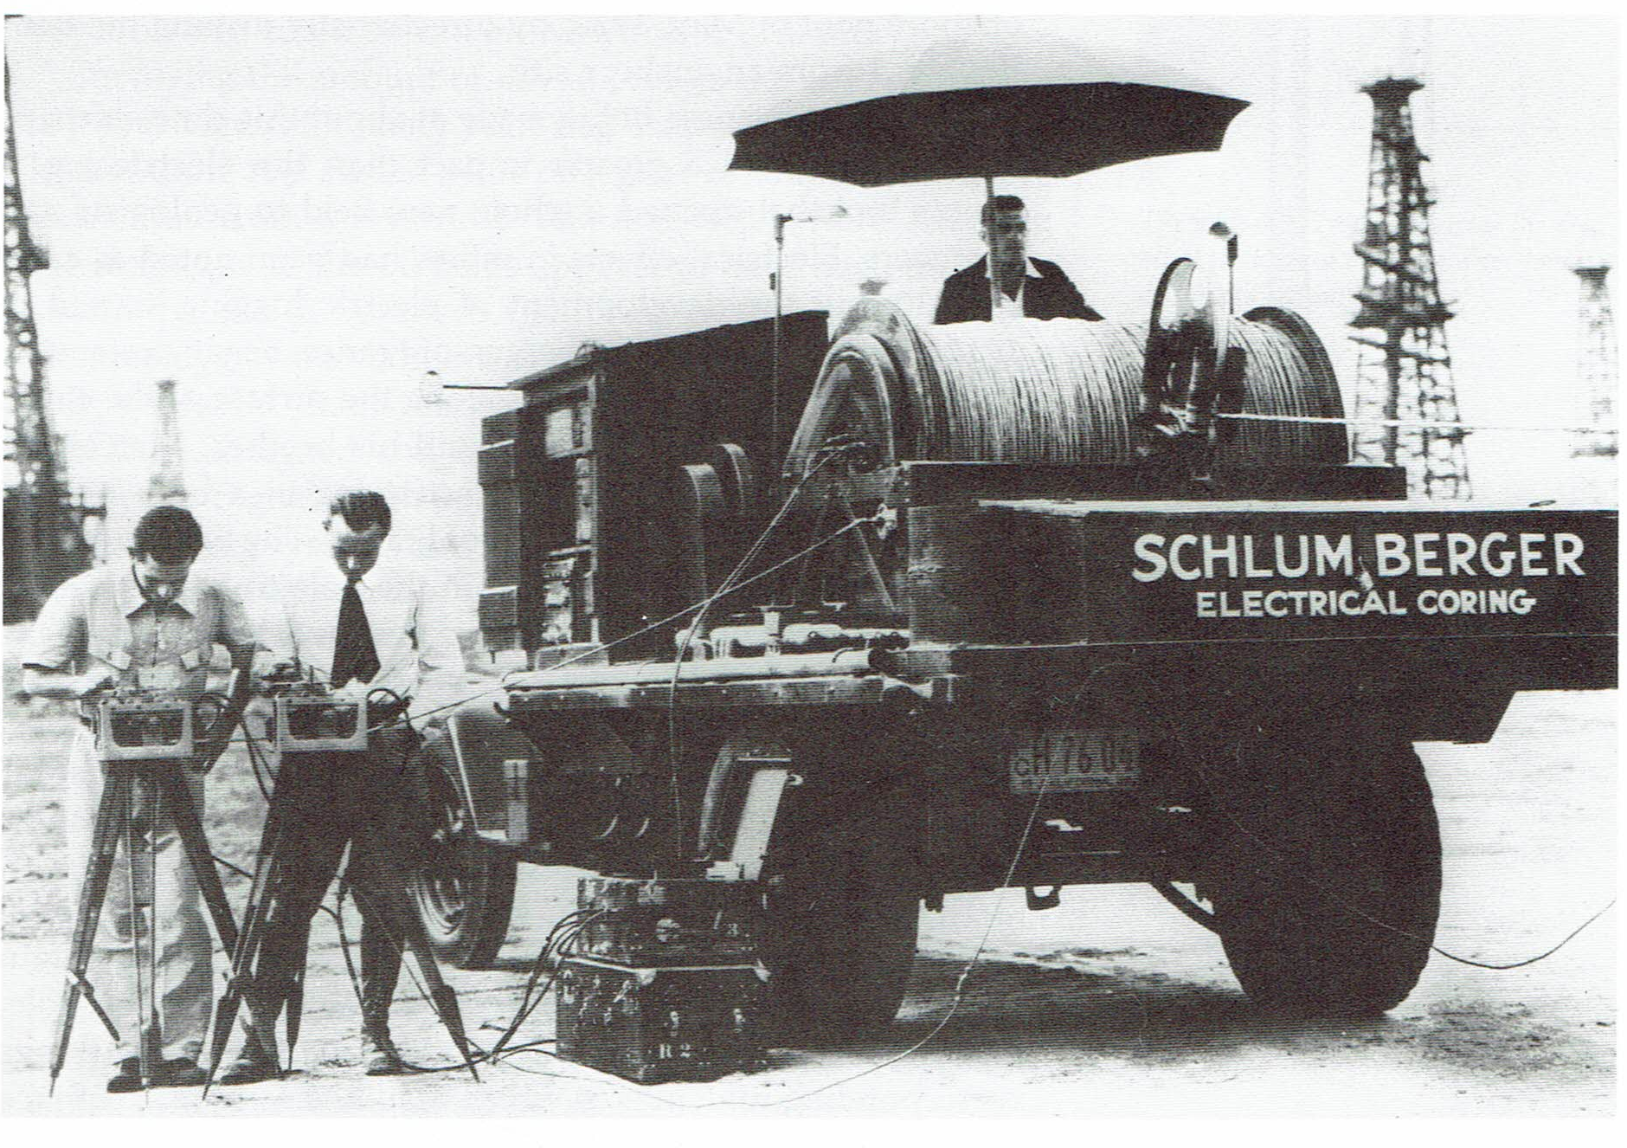
Electric Logs
Jacques Gallois made the first electric log run in California at Shell’s Boston Land Company No 1 at Westhaven near Huron, Kings County, on August 15, 1929.
Gilbert Deschatre and Jacques Gallois with the first electrical logging truck in California, 1933
Source: “Spudding In”, Bill Rintoul, 1976

Slide 6
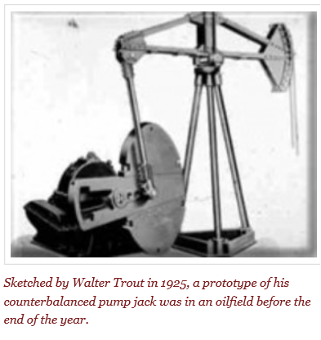
Donkey, Grasshopper, Horse-head, Thirsty Bird, and Pump Jack
1925 Beam Pump
Walter Trout was working in Texas for Lufkin Foundry & Machine in 1925 when he sketched out his idea for the now familiar counterbalanced oil well pump jack. Before the end of the year, the prototype was installed and working near Hull, Texas, in a Humble Oil Company oilfield.
Source: http://aoghs.org/technology/oil-well-pump/

Slide 7

Core Analysis
1936
Core analysis as commercial service introduced by Core Laboratories in1936
Source: http://www.corelab.com/corporate/history/

Slide 8

Computer Development
1943-46
ENIAC occupied about 1,800 square feet and used about 18,000 vacuum tubes,
Weighing almost 50 tons
Many still consider the ENIAC to be the first digital computer because it was fully functional
Source: http://www.computerhope.com/issues/ch000984.htm

Slide 9
Computers
1950-88
1950 - First stored program computer, the UNIVAC 1101 is considered to be the first computer that was capable of storing and running a program from memory.
1953 - IBM's first computer IBM publicly introduced the 701; its first commercial scientific computer.
1956 - The TX-O (Transistorized Experimental computer) is the first transistorized computer to be demonstrated at MIT
1981 - IBM introduced its first personal computer called the IBM PC. The computer had 16 KB of memory, which was expandable to 256 and utilized MS-DOS
1988 - Cray Research introduced the Cray Y-MP®, the world's first supercomputer
Source: http://www.computerhope.com/issues/ch000984.htm

Slide 10
Technology Development
1929 Controlled Directional Drilling
H. John Eastman introduces controlled directional drilling.
1933 Tricone Roller-Cone Drill Bit
Hughes introduces the first tricone roller-cone drill bit.
1941 Horizontal Well Drilling
Alexander Grigoryan, a Soviet driller, directs the first horizontal well drilling in Azerbaijan.
1949 Hydraulic Fracturing
First commercial hydraulic fracturing treatment performed in Stephens County, Oklahoma and Archer County, Texas. (Halliburton)
Source: http://www.spe.org/industry/history/timeline.php

Slide 11
Technology Development
1949 Offshore Drilling
The first offshore mobile drilling platform, the Breton Rig 20 performs in up to twenty feet of water (Hayward-Barnsdall)
1954 Jack-up Drilling Rig
Colonel Leon B Delong builds the first jack-up drilling rig (Delong Corporation)
1958 Maritime Pipelaying
The first purpose-built pipelay vessel goes into use (Brown & Root).
1961 Subsea Wells
First subsea well completed (Shell)
Source: http://www.spe.org/industry/history/timeline.php

Slide 12
Technology Development
1962 Semisubmersible Drilling
First semisubmersible drilling rig (Blue Water and Shell)
1966 Thermal Decay Time Tool
Thermal-decay-time tool developed for through-tubing production logging (Schlumberger)
1967 Oil Sands Production
Commercial production begins from Athabasca Oil Sands in Alberta, Canada (Sun)
Source: http://www.spe.org/industry/history/timeline.php

Slide 13
Technology Development
1970 Bright-spot Seismic Technology
Bright-spot seismic technology used by Shell and Mobil to evaluate tracts offered at Gulf Of Mexico lease sale.
1971 Logging System
First logging system combining gamma ray, spontaneous potential, induction spherically focused resistivity, sonic and caliper logs (Schlumberger, 1971).
1972 Polycrystalline diamond compact drill bit introduced (Christensen)
Source: http://www.spe.org/industry/history/timeline.php

Slide 14
Technology Development
1972 Mud-pulse Telemetry
Mud-pulse telemetry introduced, enabling accurate determination of bit location while drilling (Teleco)
1978 Measurement-While-Drilling
Measurement-While-Drilling technology introduced (Teleco)
1980 Electrical Submersible Pump
First variable-speed electrical submersible pump (Hughes-Centrilift)
1982 3D Seismic
3D seismic processing begins (Veritas)
Source: http://www.spe.org/industry/history/timeline.php

Slide 15
Technology Development
1983 Logging While Drilling
First quantitative Logging While Drilling resistivity sensor (Halliburton)
1984 Steerable Drilling
Steerable drilling system introduced (Norton Christensen)
1991 3D Seismic
3D seismic model processed at supercomputer workstation
1994 4D Seismic
First 4D seismic performed (CGG)
Source: http://www.spe.org/industry/history/timeline.php

Slide 16
Technology Development
1997 Subsalt Development
Mahogany field on Ship Shoal Block 349 in US Gulf of Mexico becomes first commercial subsalt development. (Phillips)
2001 Subsea Christmas Tree
First 15,000-psi working-pressure subsea Christmas tree installed (Cameron)
2011 Extended Reach Well
World's longest extended reach (ERD) well drilled on Russia's Sakhalin Island, with a length of 40,502 feet (Exxon)
Source: http://www.spe.org/industry/history/timeline.php

Slide 17
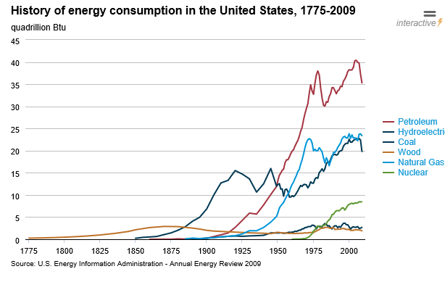
US Energy Consumption
 | Percent Coal, Gas and Petroleum
1915 | 85.9
2009 | 86.5
 | 1915 | 2009
Coal | 13.3 | 19.8
Petroleum | 1.4 | 35.3
Nat Gas | 0.7 | 23.8
Renewables | 1.7 | 1.9
Hydro | 0.7 | 2.7
Nuclear | 0.0 | 8.4
1917

Slide 18
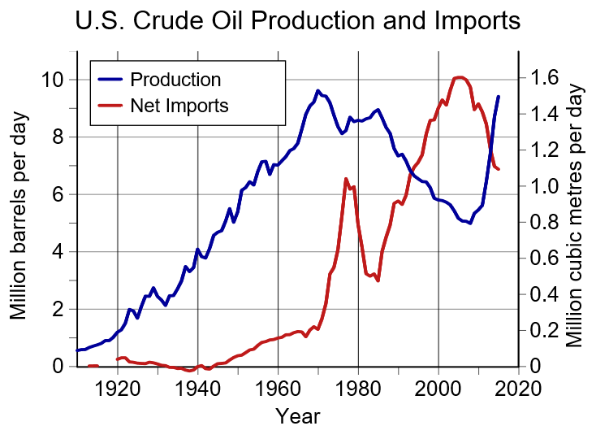
US Oil Production
Source: US Energy Information Administration. Data: Production.[1] Net imports.[2], CC BY-SA 3.0, https://commons.wikimedia.org/w/index.php?curid=24951796

Slide 19
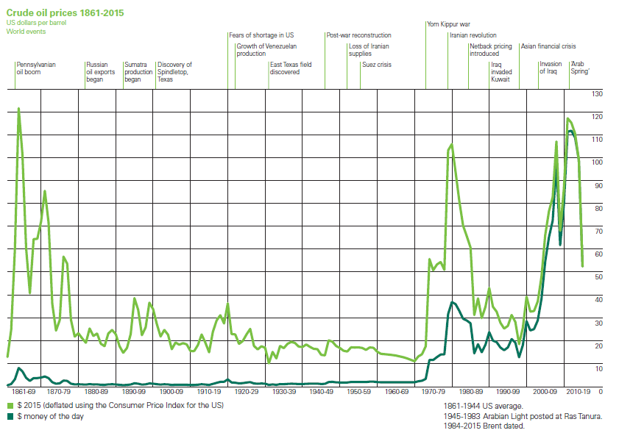
Crude Prices
Source: http://www.bp.com/content/dam/bp/pdf/energy-economics/statistical-review-2016/bp-statistical-review-of-world-energy-2016-full-report.pdf

Slide 20
The Art of Forecasting

Slide 21
The Art of Forecasting
Predictions and Forecasts
Predictions are made in world of certainty
Forecasts are in the real world
Little is certain
Nothing is preordained
What we do now affects how events unfold
The goal of forecasting is to identify the full range of possibilities
Not a limited set of illusory certainties
The consumer of forecasts are not trusting bystanders
But participants
And critics
Source: Harvard Business Review, July-August, 2007

Slide 22
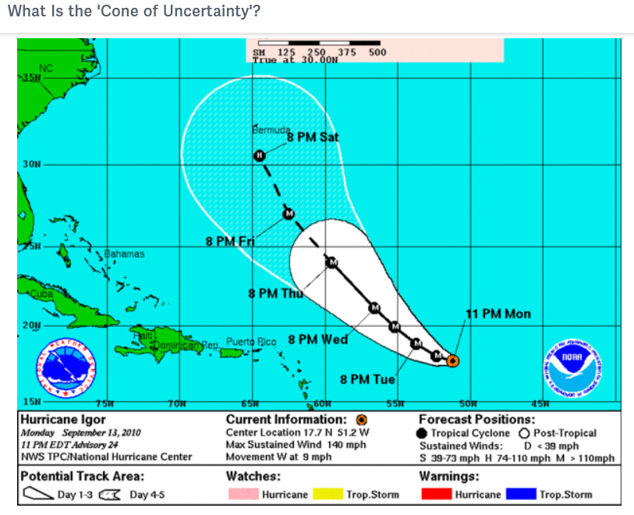
The Art of Forecasting
Cone of Uncertainty
As a decision maker, you ultimately have to rely on your intuition and judgment.
Forecasts provide essential context
Narrow your decision space for intuition
Source: Harvard Business Review, July-August, 2007

Slide 23


The Art of Forecasting
In our case we turn to the
International Energy Agency and the
Energy Information Administration
for forecast information and for carefully considered thoughts on the extent of uncertainty
Source: Harvard Business Review, July-August, 2007

Slide 24
Forecasts -Next 25 Years

Slide 25
WEO 2016 Foreword
The Paris (COP) presented the opportunity to put forward a different vision of our energy future – a world in which energy needs are fully met without dangerously overheating the planet and in a secure and affordable way.
The prospective changes to the global energy scene are not yet enough to deliver the necessary containment of CO2 emissions.
A new sense of direction pervades the international climate and energy community, not least the IEA, which is now reinforcing a role as the global “clean energy hub”.”.
We see a solid place for oil and gas in energy supply for many years to come.
Source: WEO 2016 Foreword, p 3

Slide 26
WEO 2016 Foreword
Paris presented the opportunity to put forward a different vision of our energy future – a world in which energy needs are fully met without dangerously overheating the planet and in a secure and affordable way.
A new sense of direction pervades the international climate and energy community, not least the IEA, which is now reinforcing a role as the global “clean energy hub”.”.
Our new projections reflect this. The Nationally Determined Contributions, the climate pledges tabled in Paris, are now at the heart of our New Policies Scenario.
The prospective changes to the global energy scene are not yet enough to deliver the necessary containment of CO2 emissions. But we are making progress.
Source: WEO 2016 Foreword, p 3

Slide 27
WEO 2016 Foreword
The global energy transition is gaining momentum, but traditional energy security concerns have not slipped off the agenda.
Fossil fuels have had a turbulent year. Lower oil prices persist. Gas output is buoyant, but prices are low. Swathes of the coal industry have sought bankruptcy protection.
We see a solid place for oil and gas in energy supply for many years to come and some recovery of fortunes by the next decade. But risks abound.
Future constraints do not all lie within the energy industry. Energy production needs water; and water supply needs energy. We examine the interactions and risks.
Source: WEO 2016 Foreword, p 3-4

Slide 28
WEO 2016 Introduction
In a momentous period for global energy, the entry into force of the Paris Agreement in November 2016 was a milestone in the international effort to tackle climate change, deployment of wind and solar technologies reached record levels and governments reaffirmed their intention to ensure universal energy access by 2030.
Our main scenario in WEO-2016, the New Policies Scenario, incorporates existing energy policies as well as an assessment of the results likely to stem from the implementation of announced intentions, notably those in the climate pledges submitted for COP21.
The rates at which GDP and population are assumed to grow are the principal determinants of energy demand growth. In WEO-2016, global GDP is assumed to grow at a compound average rate of 3.4% per year, slightly below the level assumed in last year’s Outlook. The world population rises from 7.3 billion in 2015 to 9.2 billion in 2040, with India overtaking China in the early 2020s as the most populous country.
Source: WEO 2016 Introduction and Scope, p 31

Slide 29
WEO 2016 Developing the Scenarios
The Current Policies Scenario depicts a path for the global energy system shorn of the implementation of any new policies or measures beyond those already supported by specific implementing measures in place as of mid-2016.
The New Policies Scenario reflects the way that governments see their energy sectors developing over the coming decades. Its starting point is the policies and measures that are already in place, but it also takes into account, in full or in part, the aims, targets and intentions that have been announced.
The 450 Scenario, which has the objective of limiting the average global temperature increase in 2100 to 2 degrees Celsius above pre-industrial levels.
Source: WEO 2016 Introduction and Scope, p 32

Slide 30
WEO 2016 Developing the Scenarios
This 2016 edition of the World Energy Outlook (WEO) looks out across an energy landscape in flux.
2015 saw additions of renewable power generation capacity exceed those of fossil fuels. The number of electric cars on the road passed one million. Most significantly, the data for 2014 and 2015 suggested that what was once a very predictable relationship between rising economic activity, growth in energy demand and energy-related carbon dioxide (CO2) emissions is starting to weaken.
In the power sector, which has the least complicated path to decarbonization, average investment costs in solar power have fallen between 40% and 80% since 2010, yet solar power still accounts for barely 1% of electricity generation worldwide.
1.3 million electric vehicles is an impressive milestone, but it is only around 0.1% of the global car fleet
Source: WEO 2016 Introduction and Scope, p 32

Slide 31
WEO 2016 Developing the Scenarios
The absence of universal energy access is a lamentable failure of the world’s energy system, with around one-in-six people in the world lacking access to electricity and two-in-five risking their health in the smoky environments caused by cooking over open fires using solid biomass as fuel.
Consumers prize reliable, affordable energy, so governments typically place a high priority on minimizing the costs of energy provision.
Public acceptance is a major constraint on policy adoption and implementation: fossil fuels are most subject to criticism, but they are not alone in facing an uncertain and difficult future.
With so many uncertainties and (occasionally competing) priorities, no path of development of the global energy system can be confidently drawn to 2040.
That is why the World Energy Outlook presents several scenarios - Current Policies Scenario, New Policies Scenario and 450 Scenario
Source: WEO 2016 Introduction and Scope, p 32

Slide 32
WEO 2016 Developing the Scenarios
the New Policies Scenario reflects the way that governments, individually or collectively, see their energy sectors developing over the coming decades. Its starting point is the policies and measures that are already in place, but it also takes into account, in full or in part, the aims, targets and intentions that have been announced, even if these have yet to be enshrined in legislation or the means for their implementation are still taking shape.
The Current Policies Scenario depicts a path for the global energy system shorn of the implementation of any new policies or measures beyond those already supported by specific implementing measures in place as of mid-2016.
the 450 Scenario, which has the objective of limiting the average global temperature increase in 2100 to 2 degrees Celsius above pre-industrial levels.
Source: WEO 2016 Introduction and Scope, p 32

Slide 33
WEO 2016 Overview
Consumption of all modern fuels continues to grow in the period to 2040 in the New Policies Scenario. Oil demand rises steadily to 103.5 mb/d in 2040; gas consumption rises by nearly 50%, overtaking coal. But renewable energy is the major growth story of the Outlook: in the power sector, 60% of all capacity additions to 2040 are from renewables.
The relationship between global economic growth, energy demand and related CO2 emissions is steadily weakening. The climate pledges made at COP21 lock in a continuation of this trend, but do not yet deliver the early peak in emissions that would be needed for a 2 °C emissions trajectory.
An early peak and then a fall in emissions consistent with the 450 Scenario would require a step-change in the decarbonization of the power sector, including measures to integrate variable renewables, and profound changes to the efficiency and carbon intensity of end-uses.
Source: WEO 2016 Introduction and Scope, p 32

Slide 34
WEO 2016 Overview
Subsidies to renewables were almost $150 billion in 2015, mostly in the power sector, but cost reductions mean ever greater deployment per dollar spent. By the 2030s, renewables subsidies are projected to be in decline, from a peak of $240 billion, and most renewables generation is competitive without subsidies by 2040. Today’s lower fossil-fuel prices have given additional impetus to pricing reforms in some countries and fossil-fuel consumption subsidies fell to $325 billion in 2015.
In various parts of the energy system, there are questions whether policies, price signals or market designs are adequate to ensure investment is made when and where it is needed. In the case of oil, an increase in new upstream project approvals, compared with the very low levels seen in 2015 (and so far in 2016) is needed. Oil remains pivotal for energy security, but natural gas and electricity security are also being pushed to the fore by changes in global energy use.
Acute deprivation persists in the global energy sector, with 1.2 billion people without electricity and 2.7 billion reliant on the traditional use of solid biomass for cooking. Achieving universal access to affordable, reliable and modern energy services by 2030 is now one of the UN Sustainable Development Goals, but our projections show today’s efforts falling short of reaching this goal.
Source: WEO 2016 Introduction and Scope, p 32

Slide 35
WEO 2016 Overview
The ten questions for the future of energy:
Has the world broken the link between rising economic activity, energy demand and energy-related CO2 emissions?
Which fuels and technologies are poised to do well?
Are there limits to growth for renewable energy?
Staying below the 2 degrees’ Celsius climate change limit: what would be required?
What can the energy sector do to reduce air pollution?
Energy investment – is capital heading where it is needed?
How might the main risks to energy security evolve over the coming years?
Are we on the path to achieving universal access to energy?
Changing places: is global spending on energy subsidies shifting away from fossil fuels and in favor of renewable energy?
Does energy reform point a new way forward for Mexico?
Source: WEO 2016 Introduction and Scope, p 32

Slide 36
WEO 2016 Overview
The global energy mix does not change easily. Although government policies, relative prices, changing costs and consumer needs all create incentives to switch fuels or to introduce a new technology in order to obtain a better energy service, in practice the energy system has a great deal of inertia.
Light bulbs and office equipment might be replaced every few years, but the lifetimes of vehicles, factories, power plants and buildings are much longer, and each bit of infrastructure locks in certain patterns of energy use.
So, in the absence of a concerted policy push or a dramatic change in relative prices, the positions of the different fuels and technologies in worldwide energy use tends to be fairly stable.
The Current Policies Scenario provides a useful example of the durability of the status quo: from a share of 81% today, the role of fossil fuels in global energy is essentially unchanged at 79% in 2040 in this scenario.
Source: WEO 2016 Introduction and Scope, p 32

Slide 37
WEO 2016 Oil Market Outlook
The pledges made at the Paris Agreement do not induce a peak in oil demand before 2040 in the New Policies Scenario.
Tight oil production in the United States has been more resilient to the drop in oil prices than anticipated.
United States all but eliminates net imports of oil by 2040.
One or two years of suppressed project approvals extended into 2017, combined with the level of demand growth seen in the New Policies Scenario, could lead to more volatile oil prices and a new boom-and-bust cycle for the industry.
Investment in oil and gas remains an essential component of an orderly transition to a low-carbon future.
Source: WEO 2016, Oil Market Outlook, Highlights, p 107

Slide 38
WEO 2016 Oil Market Outlook
The pledges made as part of the Paris Agreement do not induce a peak in oil demand before 2040 in the New Policies Scenario. The difficulty of finding alternatives to oil in road freight, aviation and petrochemicals means that, up to 2040, the growth in these three sectors alone is greater than the growth in global oil demand. There are also marked changes in the geography of demand: India becomes the leading source of future growth, while China overtakes the United States to become the single largest consuming country in the early 2030s.
Source: WEO 2016, Oil Market Outlook, Highlights, p 107

Slide 39
WEO 2016 Oil Market Outlook
The global stock of electric cars rises rapidly in the New Policies Scenario, from 1.3 million in 2015 to over 30 million by 2025 and more than 150 million by 2040, displacing 1.3 mb/d of oil. Battery costs decline to less than half today’s level, but the time required to recoup the additional investment cost of electric cars, compared with conventional cars, constrains more rapid deployment. Additional policy support could, however, lead to higher deployment: in the 450 Scenario, the global stock exceeds 710 million in 2040, displacing more than 6 mb/d of oil demand.
Source: WEO 2016, Oil Market Outlook, Highlights, p 107

Slide 40
WEO 2016 Oil Market Outlook
Tight oil production in the United States has been more resilient to the drop in oil prices than anticipated by many. The reaction to any price rebound will not be immediate. US tight oil production in the New Policies Scenario reaches a high point in the late-2020s at just over 6 mb/d. Helped by greater fuel efficiency and fuel switching, the United States all but eliminates net imports of oil by 2040.
Source: WEO 2016, Oil Market Outlook, Highlights, p 107

Slide 41
WEO 2016 Oil Market Outlook
Declines in production from existing conventional crude oil fields are equivalent to losing the current oil output of Iraq from the global balance every two years, providing a powerful underlying stimulus for the current rebalancing of the oil market. Yet there is also the risk of an over-correction: the volume of conventional crude oil resources receiving development approval in 2015 fell to its lowest level since the 1950s and the data for 2016 show no sign of a rebound. There is scope to recover from one or two years of suppressed project approvals, but with the level of demand growth seen in the New Policies Scenario, prolonging this into 2017 or beyond could lead to more volatile oil prices and a new boom-and-bust cycle for the industry.
Source: WEO 2016, Oil Market Outlook, Highlights, p 107

Slide 42
WEO 2016 Oil Market Outlook
There is no reason to assume widespread stranding of upstream assets for oil, even in a drive to decarbonise the energy sector, as in the 450 Scenario, provided governments pursue unambiguous policies to that end. Investment in oil and gas, albeit at reduced pace, remains an essential component of an orderly transition to a low-carbon future. But abrupt changes to climate policymaking or misjudgements of future oil demand by the oil industry could lead to more severe financial losses.
Source: WEO 2016, Oil Market Outlook, Highlights, p 107

Slide 43
WEO 2016 Gas Market Outlook
Global natural gas demand grows by nearly half over the outlook period in the New Policies Scenario.
The annual growth rate of 1.5% is lower than the 2.3% observed over the past 25 years, but gas is nonetheless the fastest growing among the fossil fuels and increases its share in global primary energy demand from 21% today to 24% in 2040.
In contrast, in the 450 Scenario, gas use plateaus from the 2030s, but as a relatively clean and flexible fuel, gas still sees its share increasing slightly.
Source: WEO 2016, Oil Market Outlook, Highlights, p 107

Slide 44
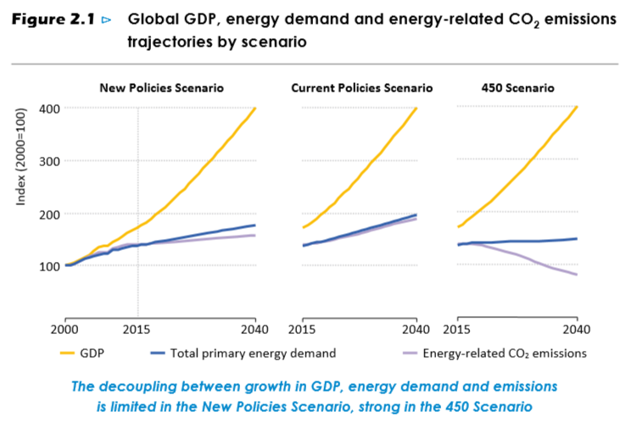
World Energy Demand
Source: WEO 2016, Table 2.1, p 60

Slide 45
Future World Energy Demand
Source: WEO 2016, Table 2.1, page 61

Slide 46
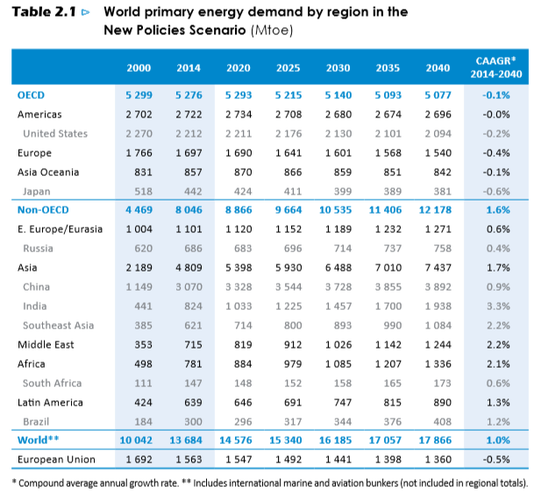
Future World Energy Demand
Source: WEO 2016, Table 2.1, page 61

Slide 47
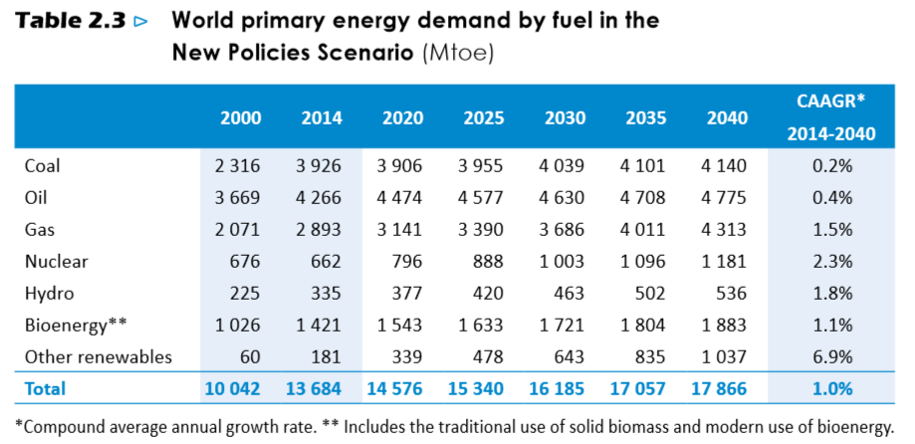
World Energy Demand
Fraction oil, gas and coal
81% 74%
Fraction oil and gas
52% 51%
Source: WEO 2016, Table 2.3, p 65

Slide 48
World Energy Demand
Source: WEO 2016, Table 2.3, p 65

Slide 49
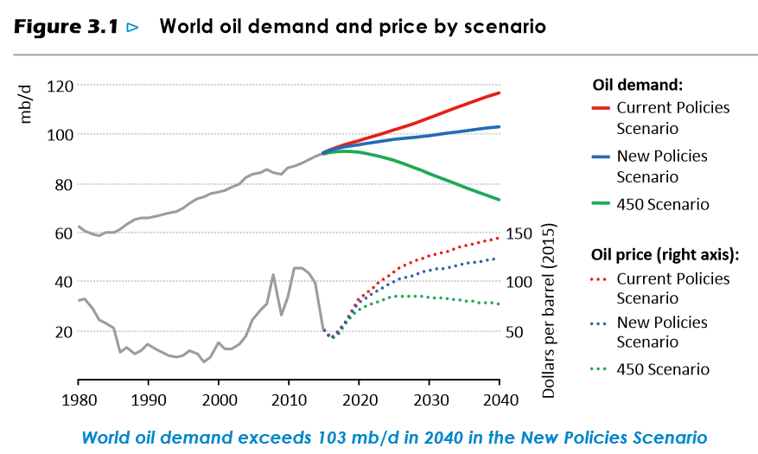
Global Oil Demand
Source: WEO 2016, Figure 3.1, P 110

Slide 50
Global Oil Demand
Source: WEO 2016, Table 3.2, p 115

Slide 51
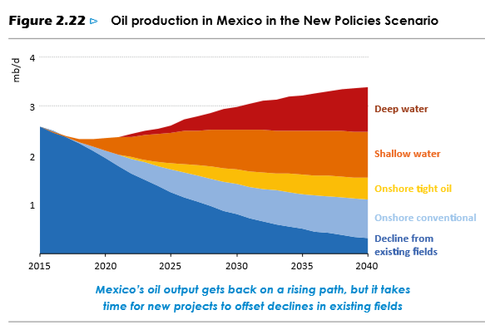
Mexico Oil Production
Source: WEO 2016, Figure 2.22, p 102

Slide 52
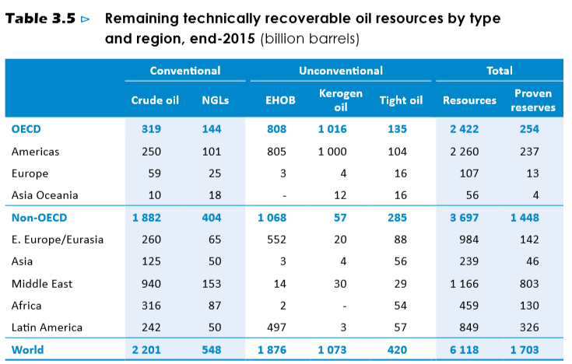
Global Oil Resource
Source: WEO 2016, Figure 3.5, P 128

Slide 53
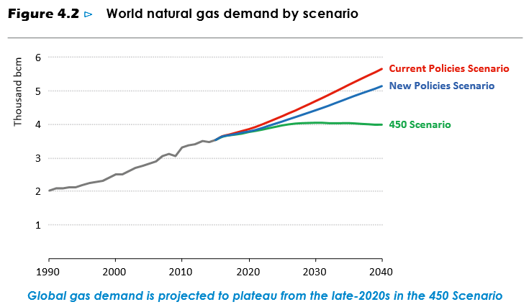
Global Gas Demand
Source: WEO 2016, Figure 4.2, P 166

Slide 54
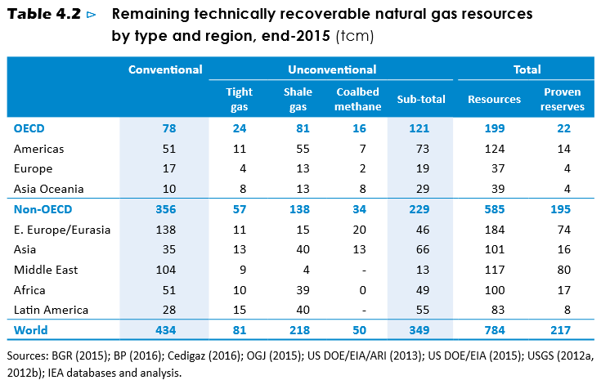
Global Gas Resources
Source: WEO 2016, Table 4.2, P 176

Slide 55
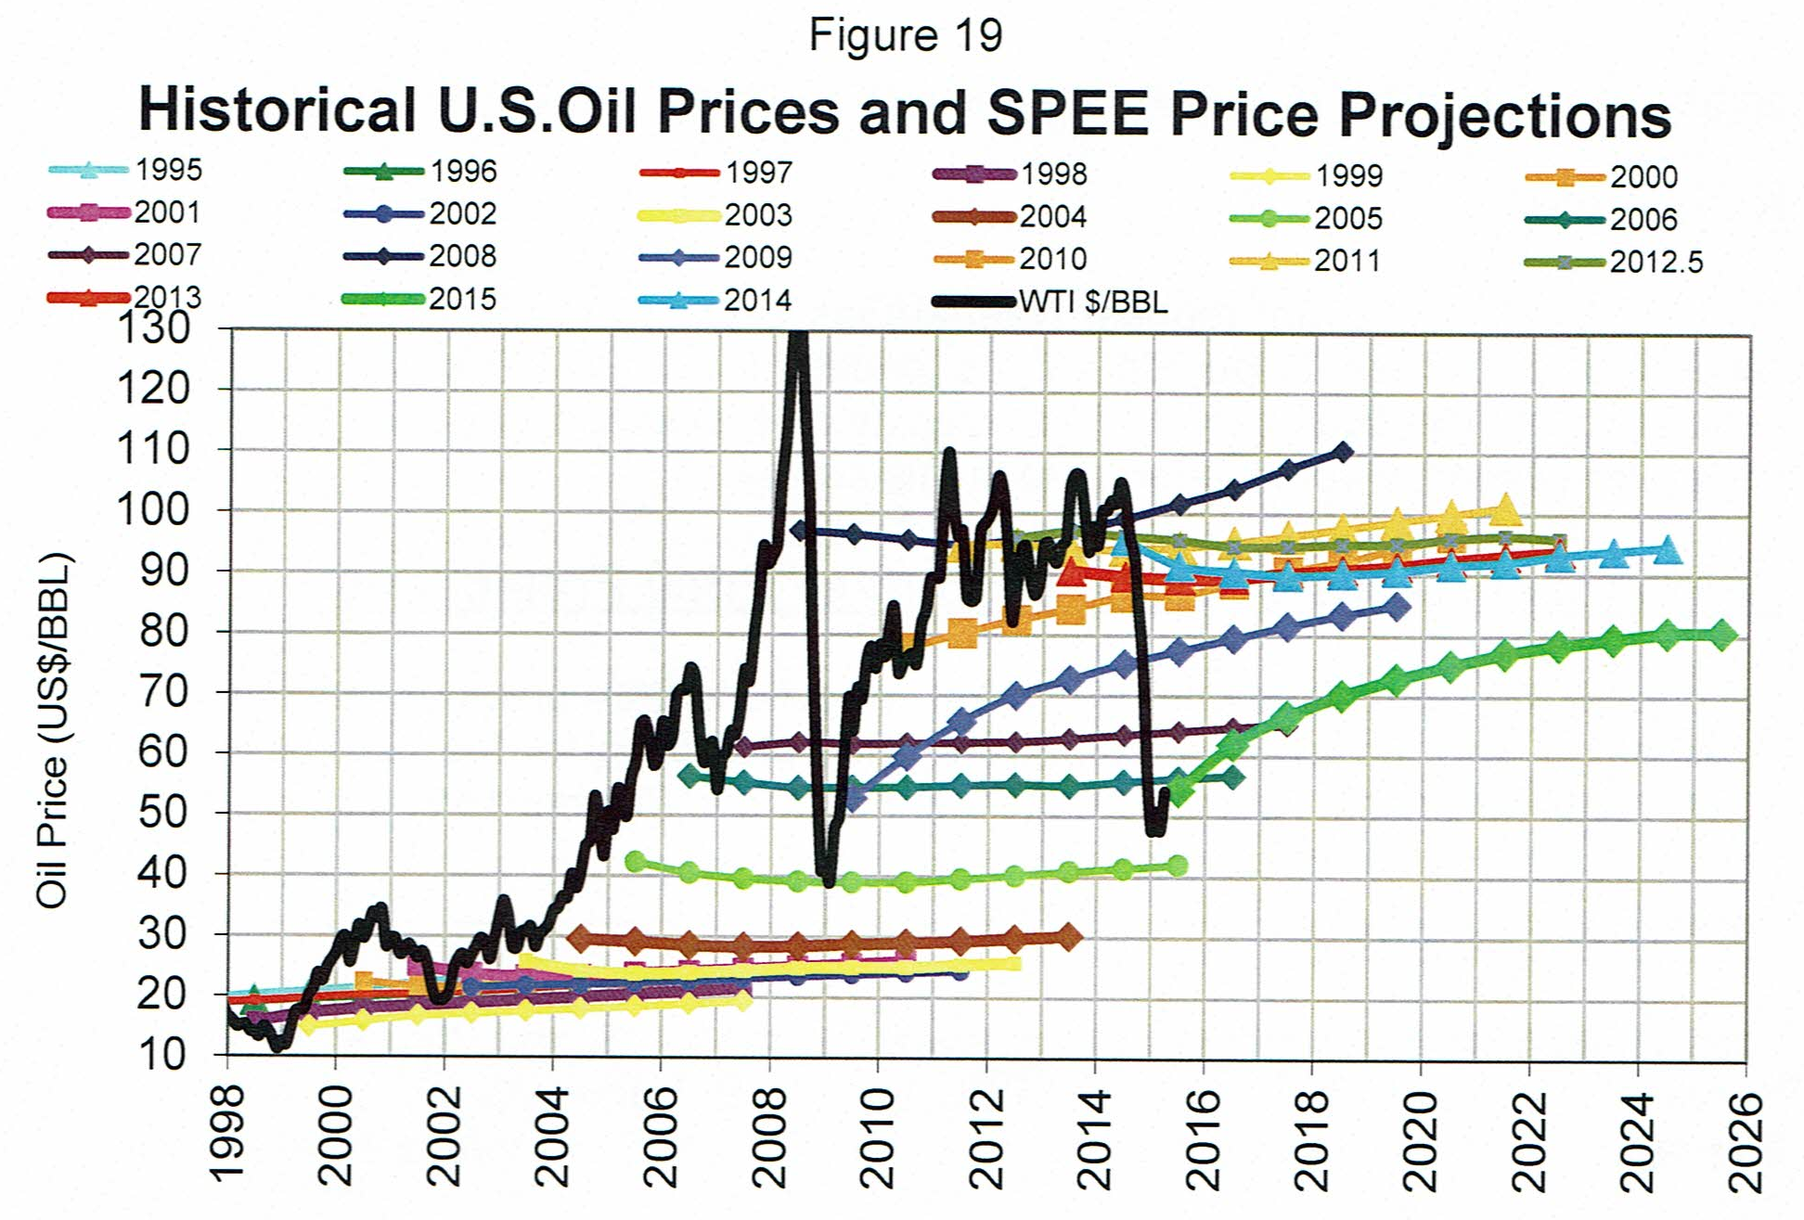
Oil Price Forecasts
Source: SPEE Survey, June 2015, page 16

Slide 56
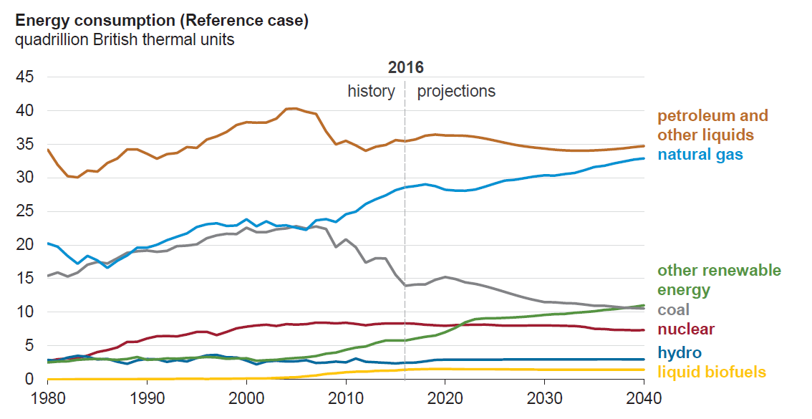
US Energy Consumption
Source: EIA AEO 2017, page 9

Slide 57
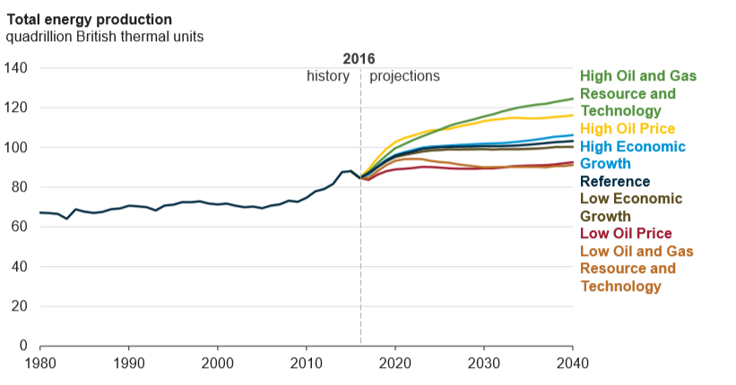
US Total Energy Production
Source: EIA AEO 2017, page 11

Slide 58
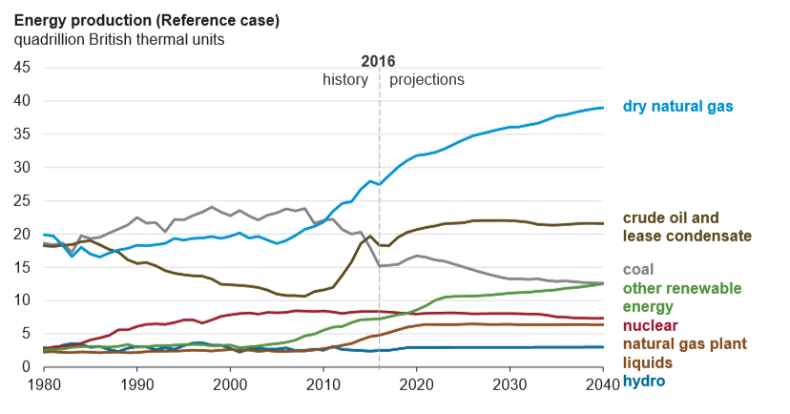
US Energy Production
Source: EIA AEO 2017, page 13

Slide 59
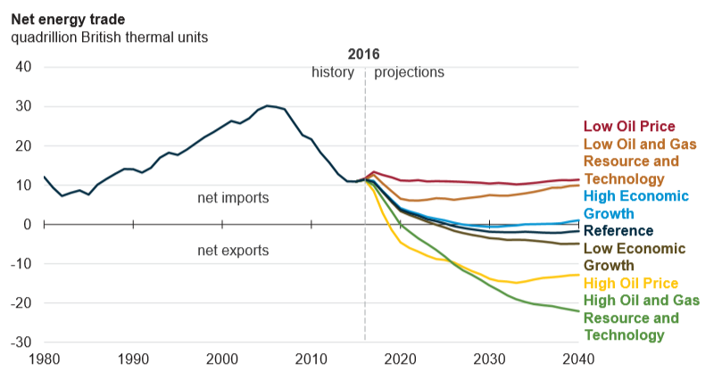
US Energy Trade
Source: EIA AEO 2017, page 15

Slide 60
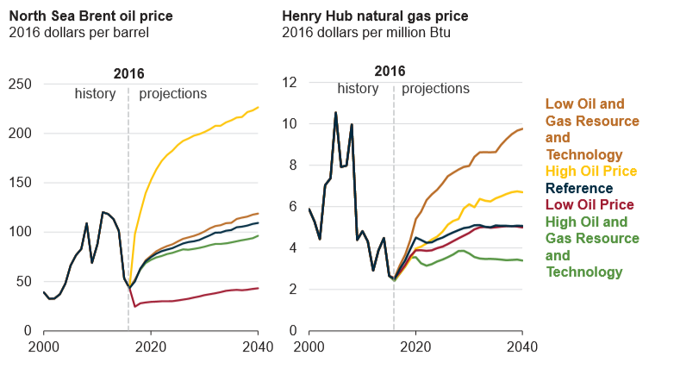
US Energy Prices
Source: EIA AEO 2017, page 27

Slide 61
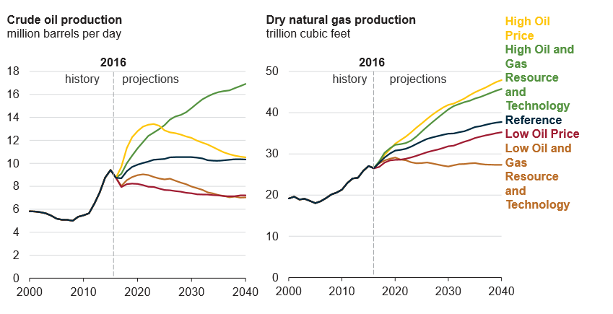
US Energy Production
Source: EIA AEO 2017, page 29

Slide 62
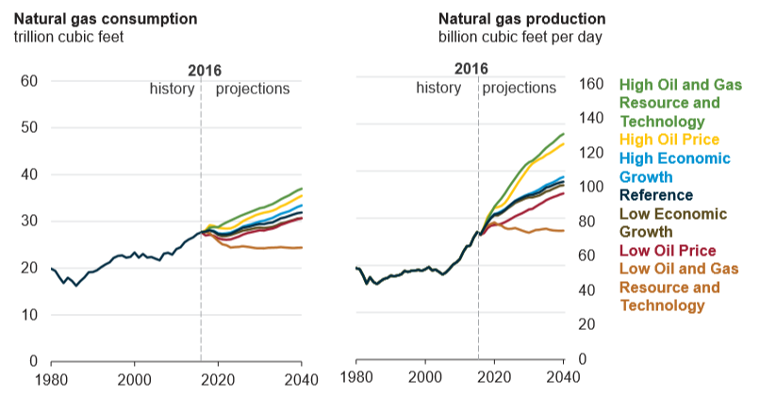
US Natural Gas
Source: EIA AEO 2017, page 53

Slide 63

The Next 100 Years
So, what will the industry be like in 2117?
2017 SPEI Board of Directors

Slide 64

The Next 100 Years
So, what will the industry be like in 2117?

Slide 65

Switch Energy Project
For another view, see ‘Switch’ by Scott Tinker, Director BEG at UT.
Also AAPG’s January 2017 Explorer Magazine, page 10
“Scott might have the best overview of energy on the planet.”

Slide 66
Conclusions
Much of what we use today has been developed within the last 100 years.
We can hardly imagine what technology will be like in 2117.
Autonomous vehicles
Drones
AI
Remote operations
????

Slide 67
Conclusions
Various cones of uncertainty help to focus our intuition.
Oil and gas will play an important role in energy supply for the next 25 years
This is true whether you support Climate Change or not.
Careers in oil and gas look secure.
Ours is, and will continue to be, a great business to be in.

Slide 68
Questions?

